Slide 1


Amazon Sales Analysis

Slide 2
Contents:
Problem statement
Key metrics
Dashboarding(Tableau)
Insights
Recommendations
Github Link
Conclusion

Slide 3

Problem Statement
Sales management has gained importance to meet increasing competition and the need for improved methods of distribution to reduce cost and to increase profits. Sales management today is the most important function in a commercial and business enterprise.
Develop a report by ETL: Extract-Transform-Load some Amazon dataset and find for me Sales-trend -> month-wise, year-wise, yearly_month-wise
Find key metrics and factors and show the meaningful relationships between attributes.

Slide 4
Key Metrics
Revenue & Profit
Delivery time
Unit Cost
Profit Generated By Differet channels
Total Revenue : 41.23 M
Average delivery time: 20
Total unit cost: 5 K
Total profit : 11.96 M
Offline channel : 8.16M
Online Channel : 3.80 M

Slide 5
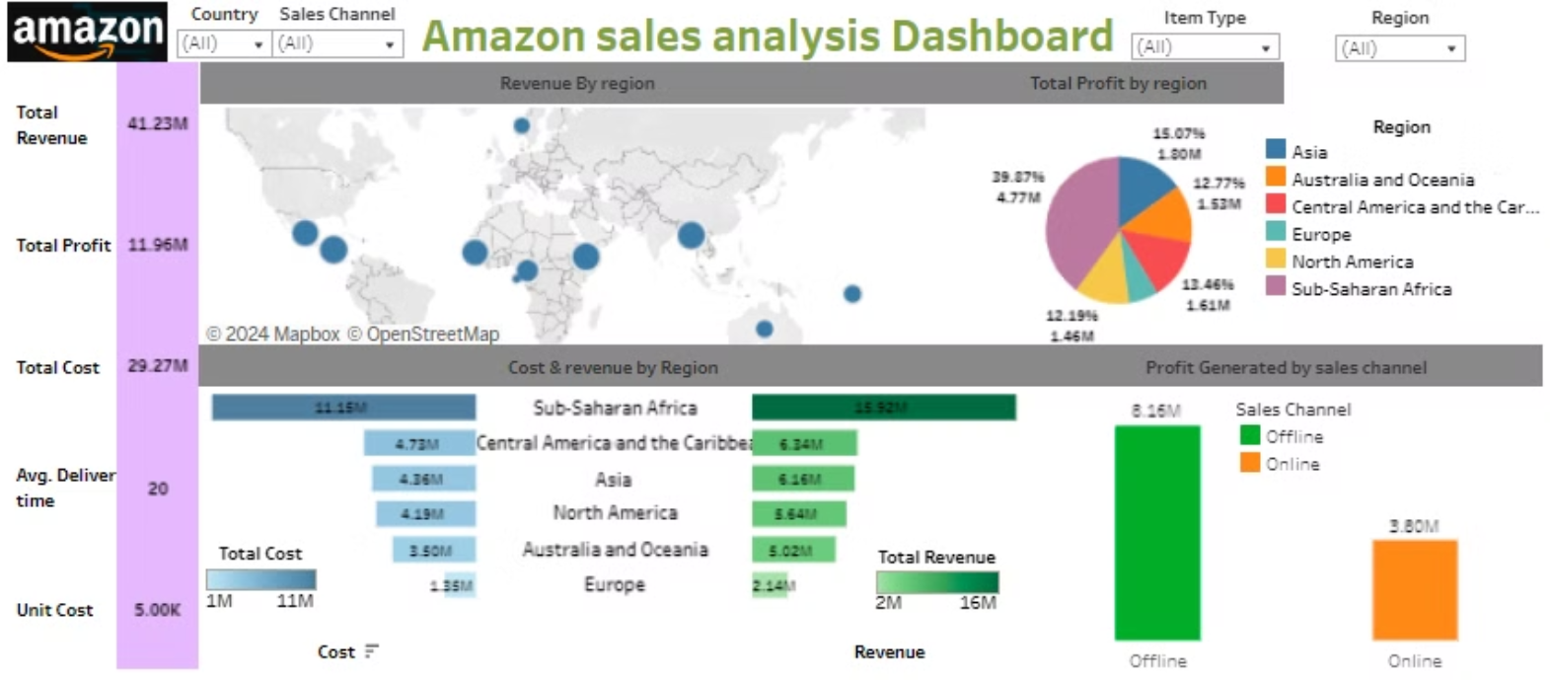
Dashboard (Tableau)
Dashboard 1:
Amazon sales analysis

Slide 6
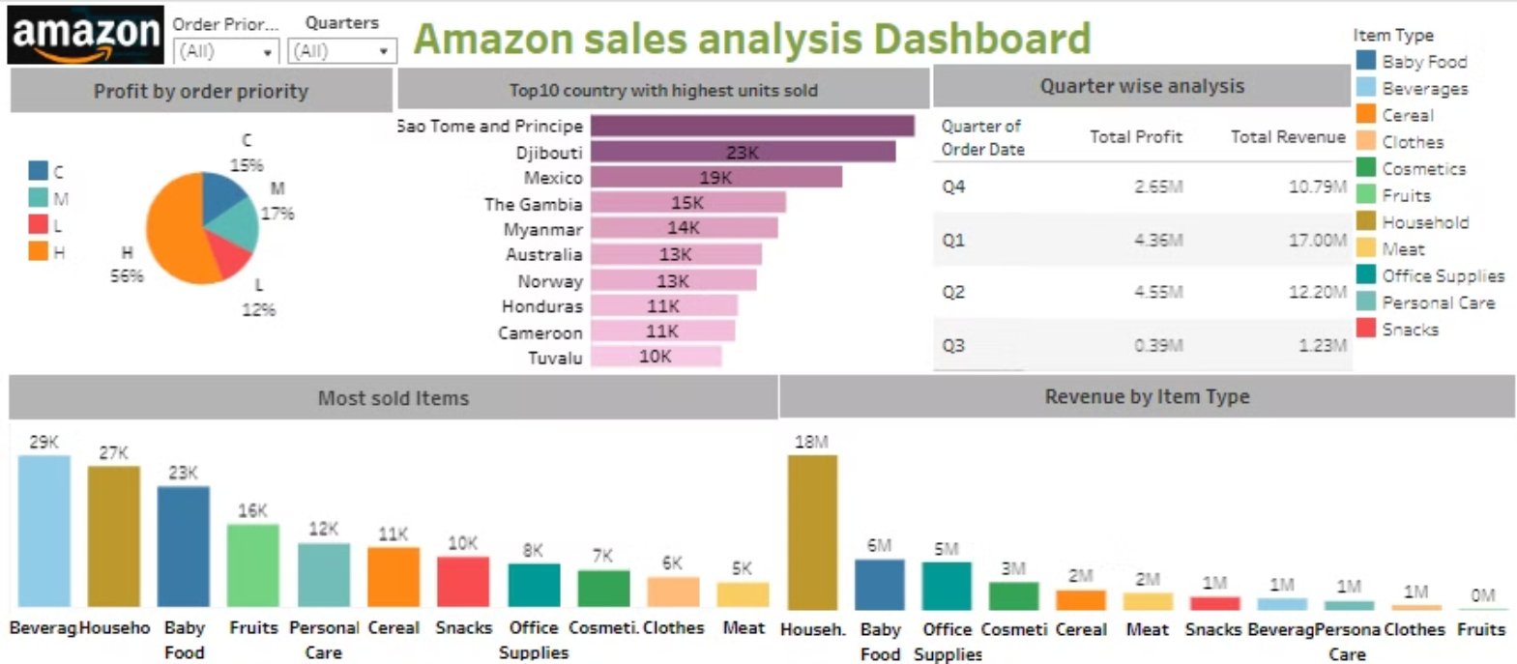
Dashboard 2:
Amazon sales analysis

Slide 7
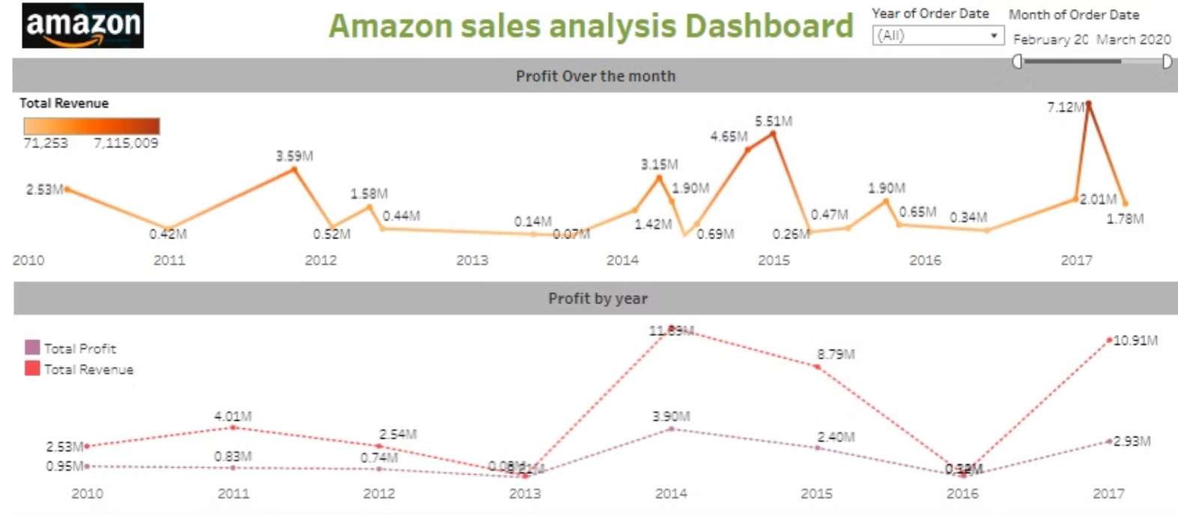
Dashboard 3:
Amazon sales analysis

Slide 8
Insights:
2014 had the highest Revenue Generated at 11.89 M, And in year 2014 also highest Profit was generated og 3.90 M.
In the Month of Feburary 2017 highest Revenue was generated of 7.12M(approx).
In first Quarted Highest Number of Revenue was generated and In Q2(Quarter 2) highest number of units were sold. and In Q3 least profit, revenue and units were solds.
Highest selling item is Beverages followed by Household items. least selling item were cloths and Meat.
High Revenue generated item is Household with a very signifincant number of 18M followed by Baby food (6M). least selling item were Fruits, Personal Care, beverages, snacks, cloths and Meat.
Amongst the top 10 countries, the sales for the Sao Tome and Principe is highest among all countries and lowest in Tuvalu.
Highest order Priority given to H type(contains 56% of the total percentage).
High Revenue Generated Region is Sub saharan Africa and least is Euprope. Asia is in 3rd rank.

Slide 9




Recommendations:
Enhance Customer Experience
Implement personalized recommendations, improve product selection, and streamline the purchasing process.
Expand into New Markets
Identify and capitalize on emerging growth opportunities in international markets.
Optimize Operations
Streamline the supply chain, logistics, and inventory management to improve efficiency and reduce costs.

Slide 10
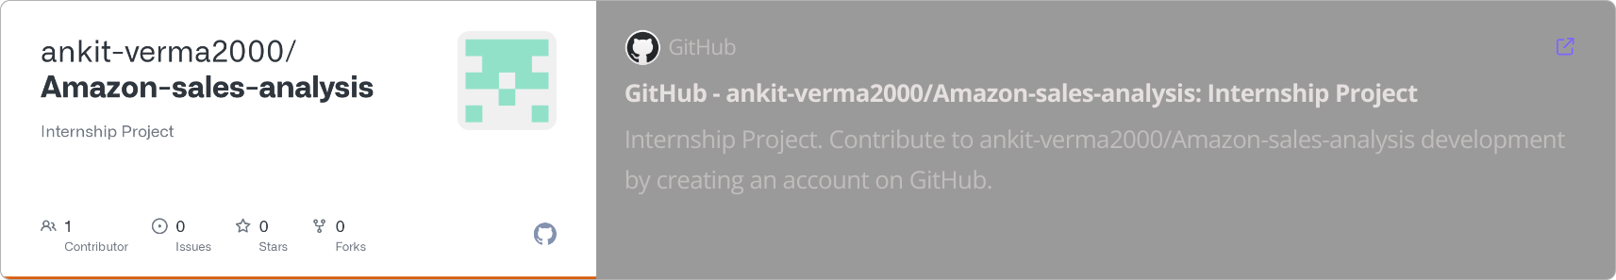
Github link:
For more analysis and recommendation:

Slide 11




Conclusion
Growth Potential
Amazon has significant opportunities to drive sales growth by enhancing the customer experience, expanding into new markets, and optimizing its operations.
Innovation
Embracing new technologies, developing unique product offerings, and staying ahead of market trends will be crucial for Amazon's continued success.
Adaptability
Amazon must be agile and responsive to changing consumer behavior, competitive landscape, and market conditions to maintain its leadership position.

